Slide 1
MI 450 Final Presentation
MI 450 Spring Semester 2017
Kristen Nakis
Grace Freeman
Joe Tang

Slide 2

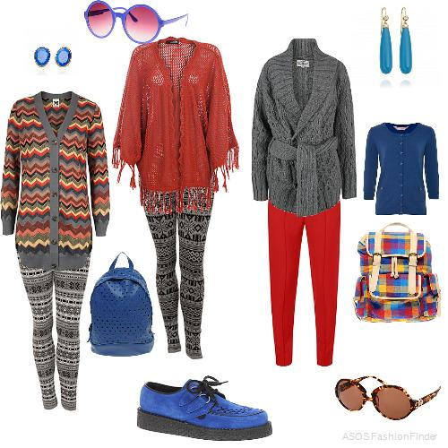

What’s the Problem….?
Getting dressed in the morning is hard. In the ever changing world of fashion, weather condition, events to attend… sometimes we just get overwhelmed by the world of clothes. Often, people forget the many combinations available to them just waiting behind their closet doors. Wouldn’t it be nice if something helped us make those pesky fashion decisions, organized our clothes and made for a more efficient way to get dressed? There must be something…

Slide 3
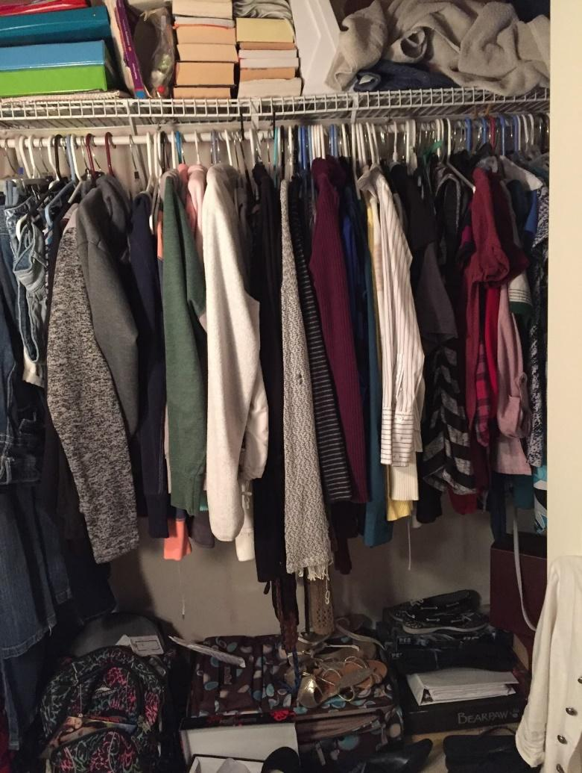
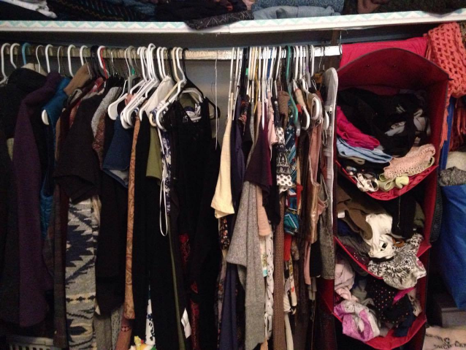
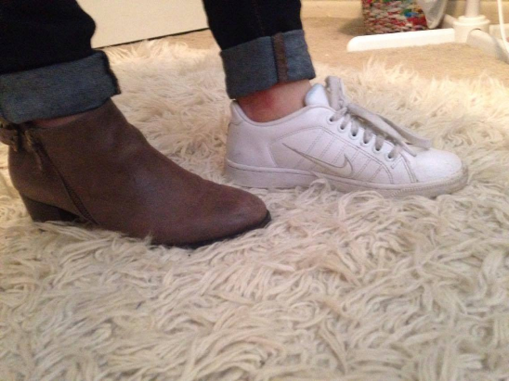
Interviews
Findings
What do people want?
Who would use this..? (Not just women!)
What issues do people have in this area?
People often forget about items in closet
Aren’t sure what is appropriate to wear
People felt unorganized, unmotivated, unprepared

Slide 4
Scenario 1
Person wakes up late to work and needs to get dressed immediately
-speed is the focus
-allows people to make decisions before they are in a rush
design choices
-the function has to be immediate
-make it more like planning than exploration

Slide 5
Scenario 2
Person wants to explore their closet
-highlight things that normally aren’t visible
-give information on the clothing
design choices
-give as much information to the user as possible
-recognition rather than recall

Slide 6
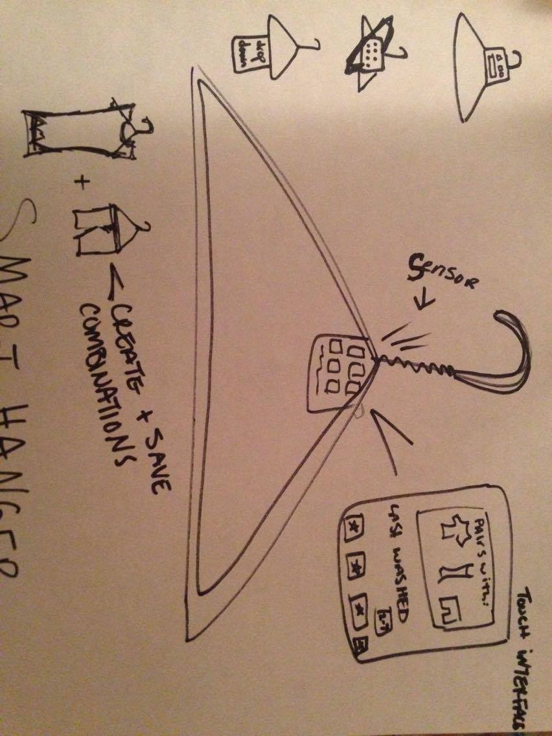
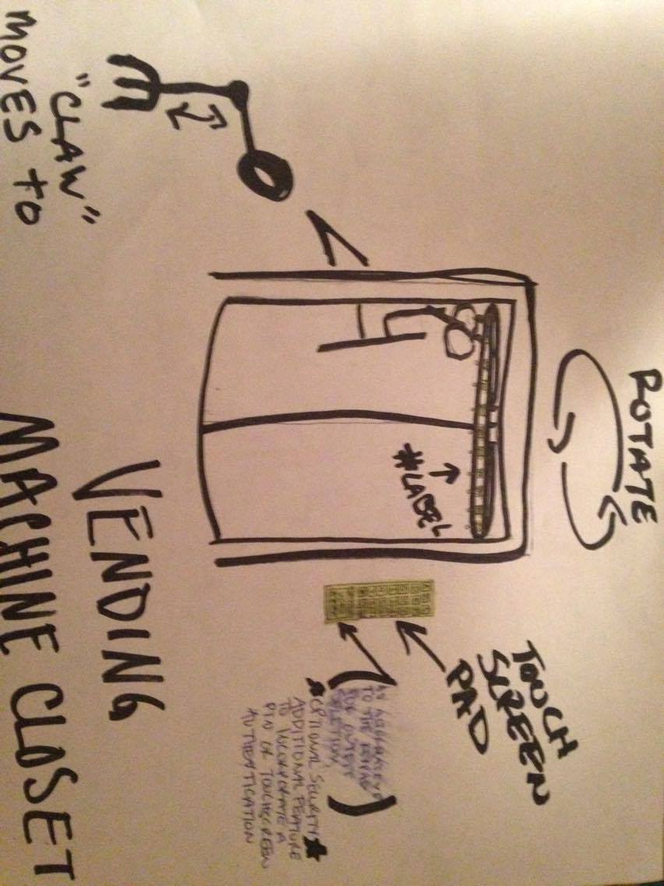
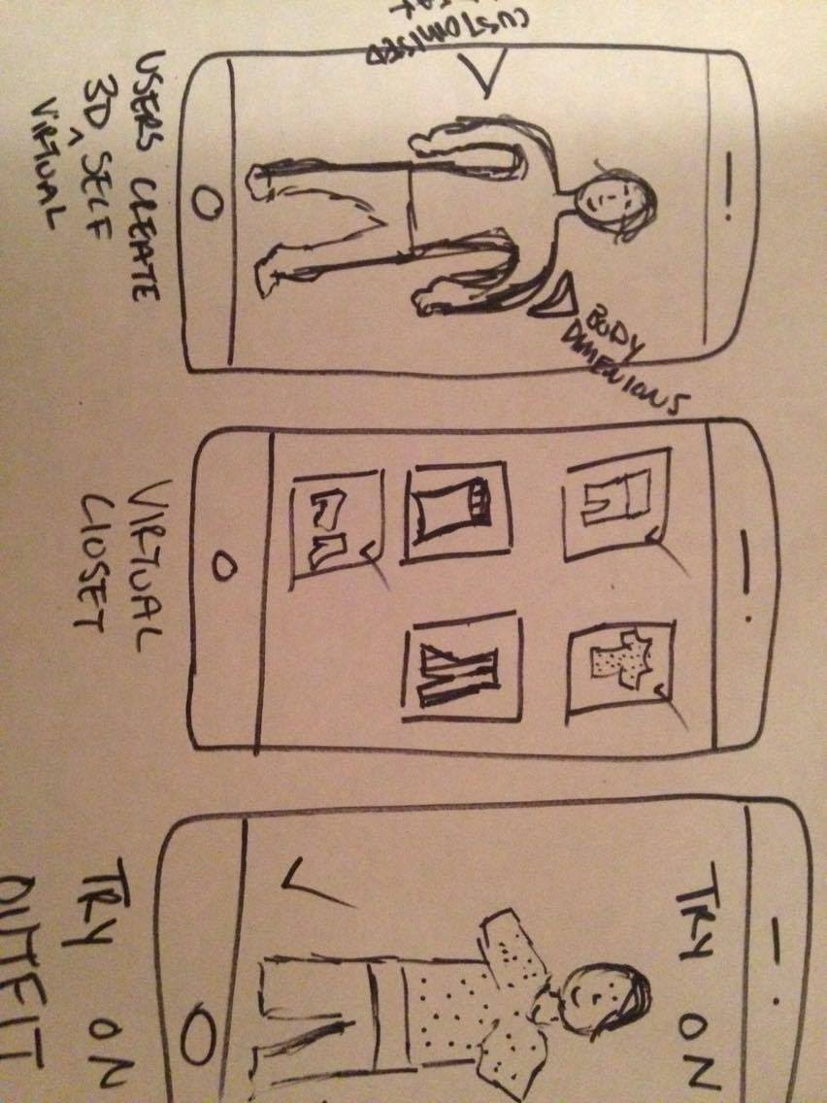
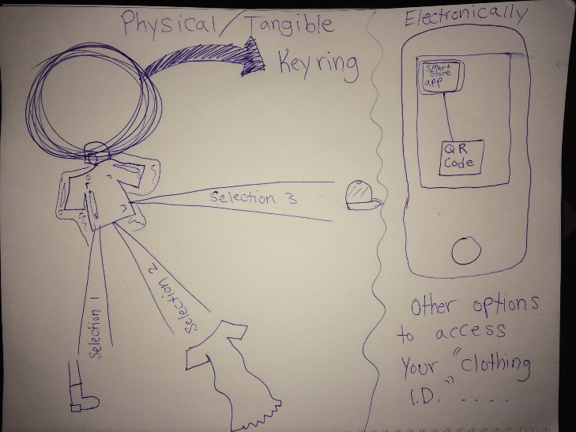
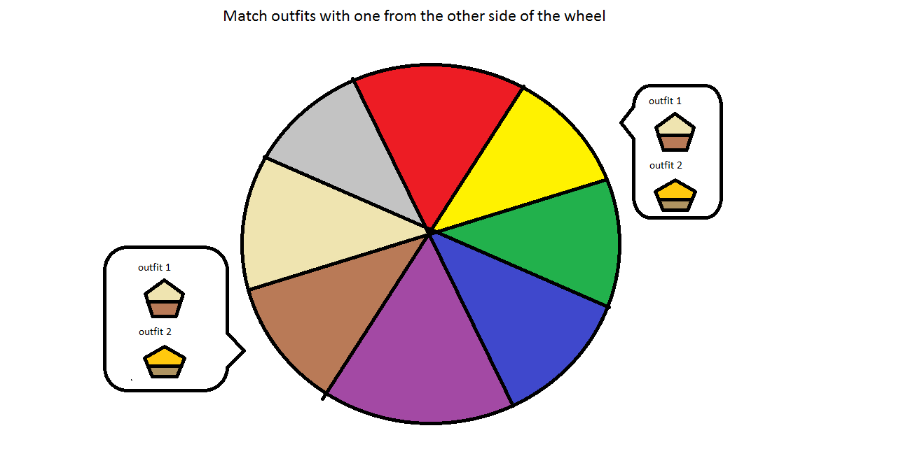
Initial ideas
Smart hanger
Vending Machine closet
Fashion app
Retail vs in the home

Slide 7





Solution
Not just “another app” + physical interaction between user and clothing in closet + engaging & informative = SMART HANGER!

Slide 8
What is the SMART HANGER?
Internet of things: Interconnectivity
Fuses physical with virtual
“Tag”-looking device can be looped on hanger
More unique, fun, simple
Better environment for user, beneficial
Notes:
Kristen: So this physical smart hanger device would be connected to the network, but in the user’s physical environment which would be their closet. Our main idea for creating this smart hanger device is to ensure we are making something that would be helpful and useful to our users. By allowing our users to use our mobile application, we wanted to make it more convenient for them to check what they could wear or pair together without having to search through their whole closet. With the light system we created for this physical smart hanger, it will flash another item of clothing in your closet if you need to locate it quicker and are in a hurry.

Slide 9
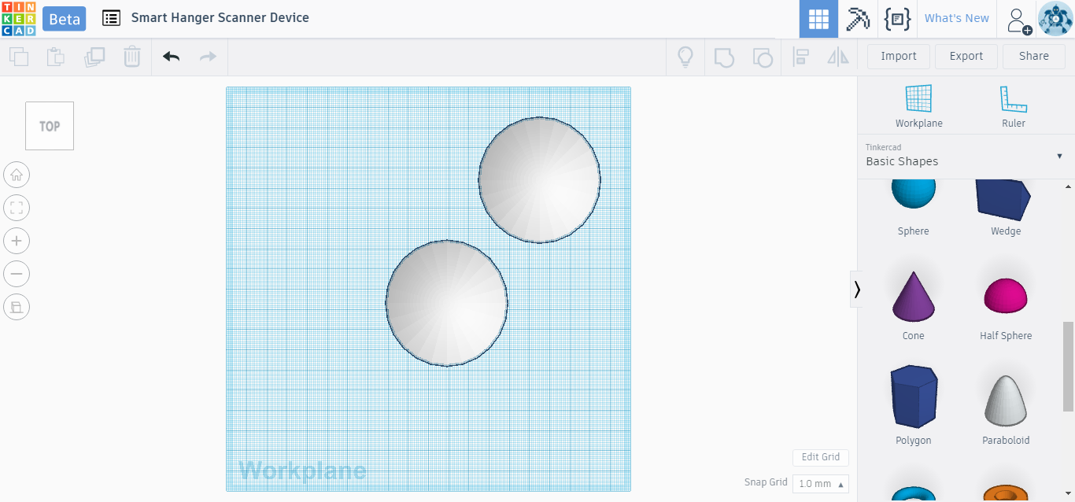
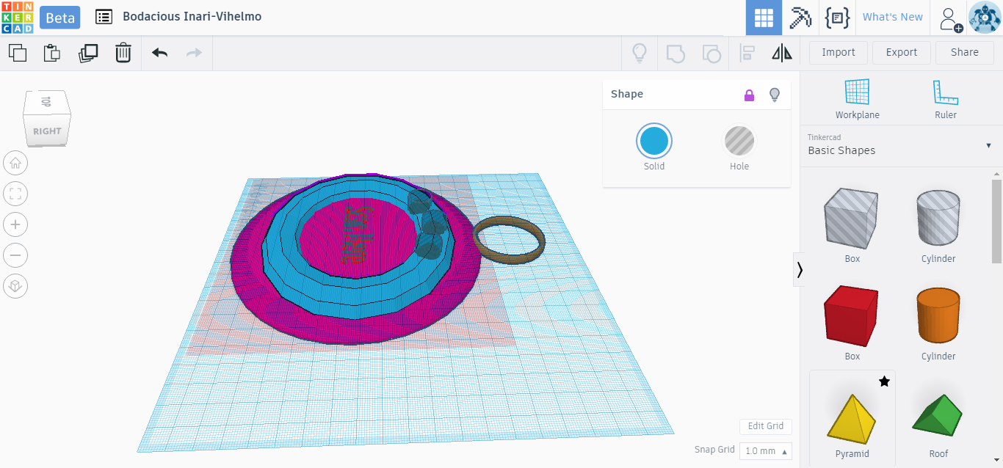
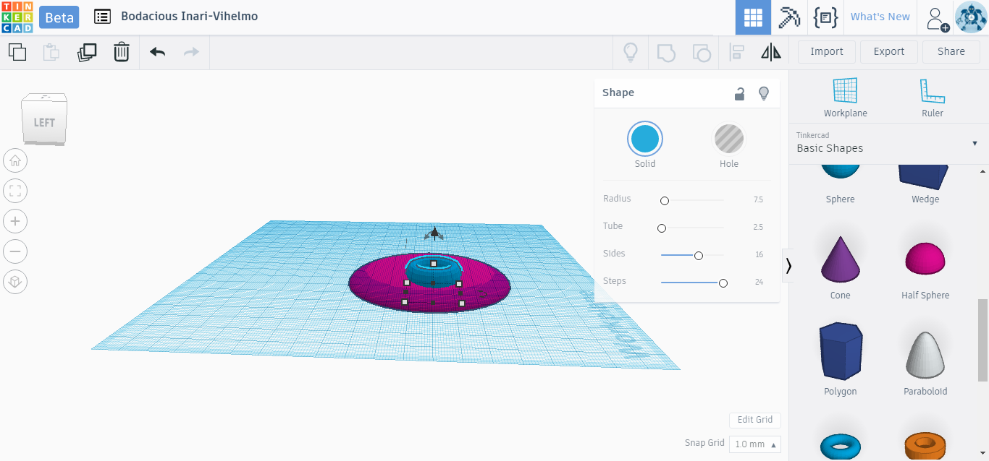
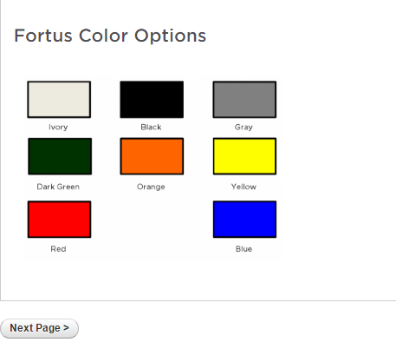
The Creation Process - Smart Hanger Device
3
1
2
4
Notes:
Kristen: for our physical high-fidelity prototype I just wanted to share what the creation process for it was like using the program TinkerCAD.

Slide 10
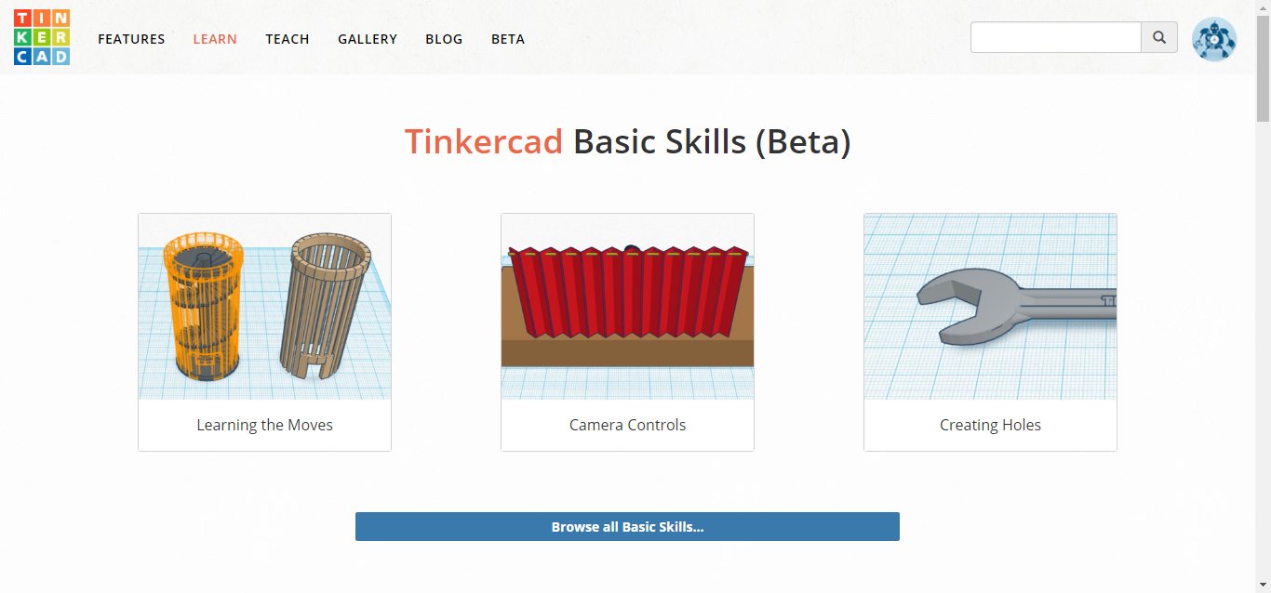
The Creation Process - Smart Hanger Device
Notes:
Kristen. These were the training tutorials you could use on how to attach objects to each other and how to create holes and other things. I liked these tutorials because rather than watching a video on how to do it, you’re using the tools in real time while it tells you what to do, and if you get stuck it will always show you what you should do next and guides you what to do or click next.

Slide 11
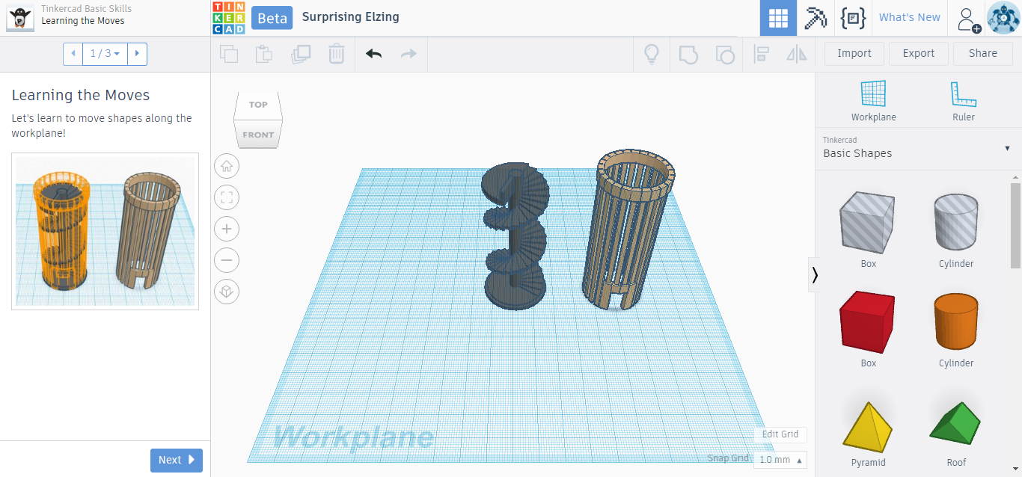
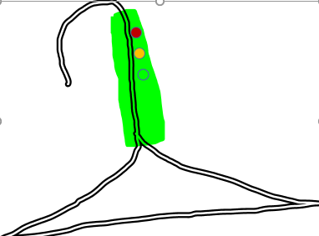
Smart Hanger Prototype Revision 2…….
A more natural fit
Notes:
Kristen. If I would have been able to use the 3D printer a second time, I would change the shape completely to be more of a cylinder or some sort of rectangle and the device would be way smaller. I feel like that way the device would have a more natural and subtle look on the hanger, so it’s not such a big bulky distraction when approaching your closet.

Slide 12
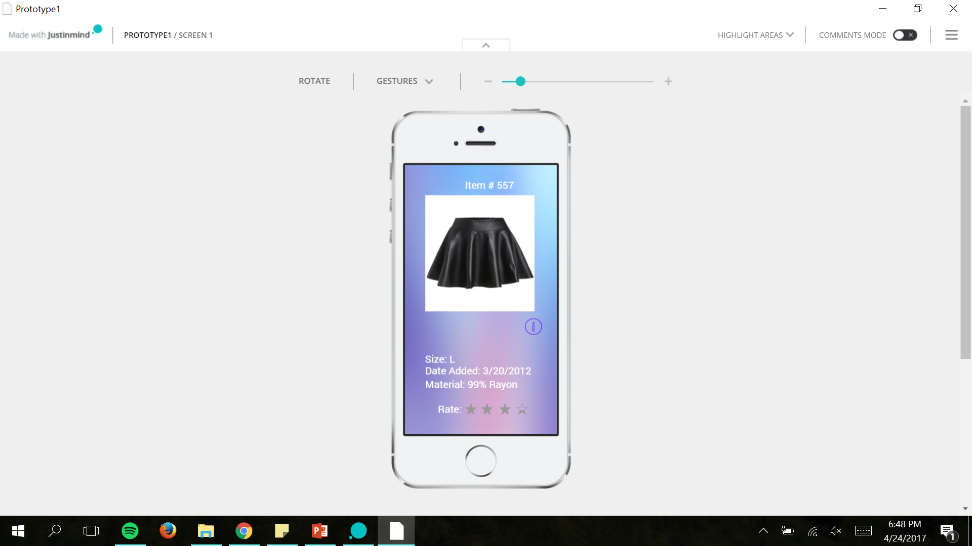
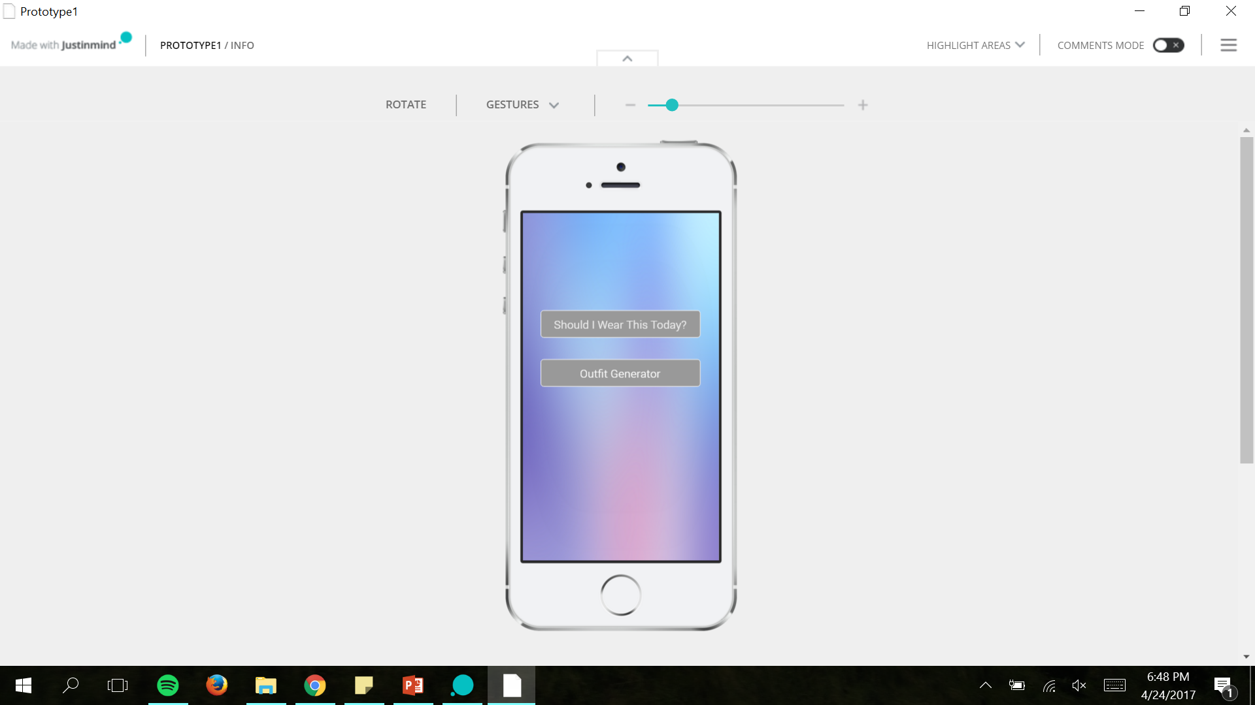
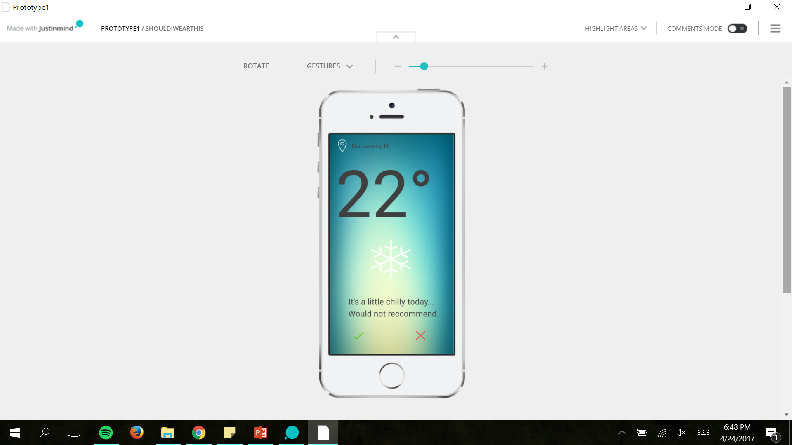
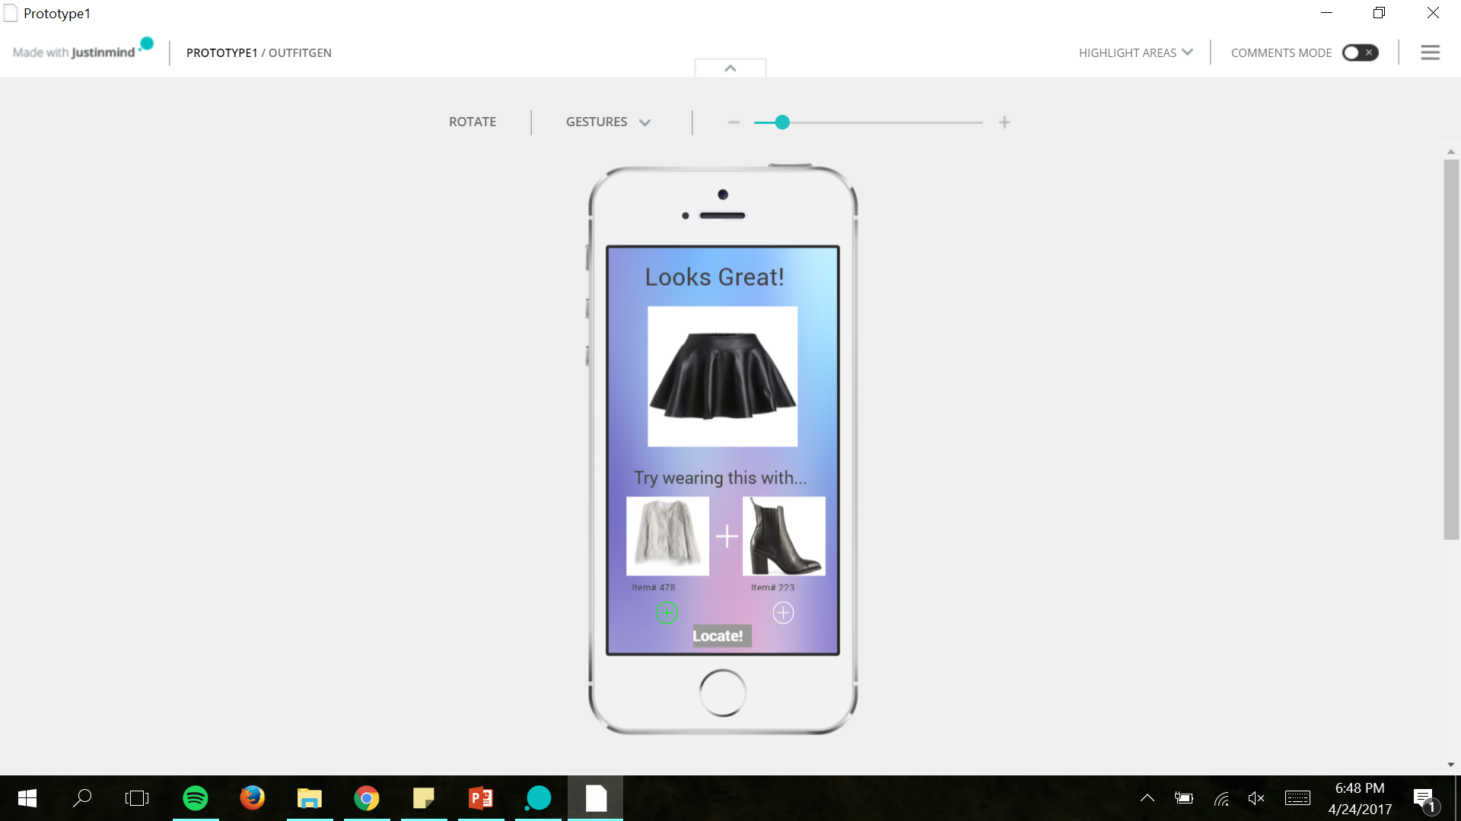
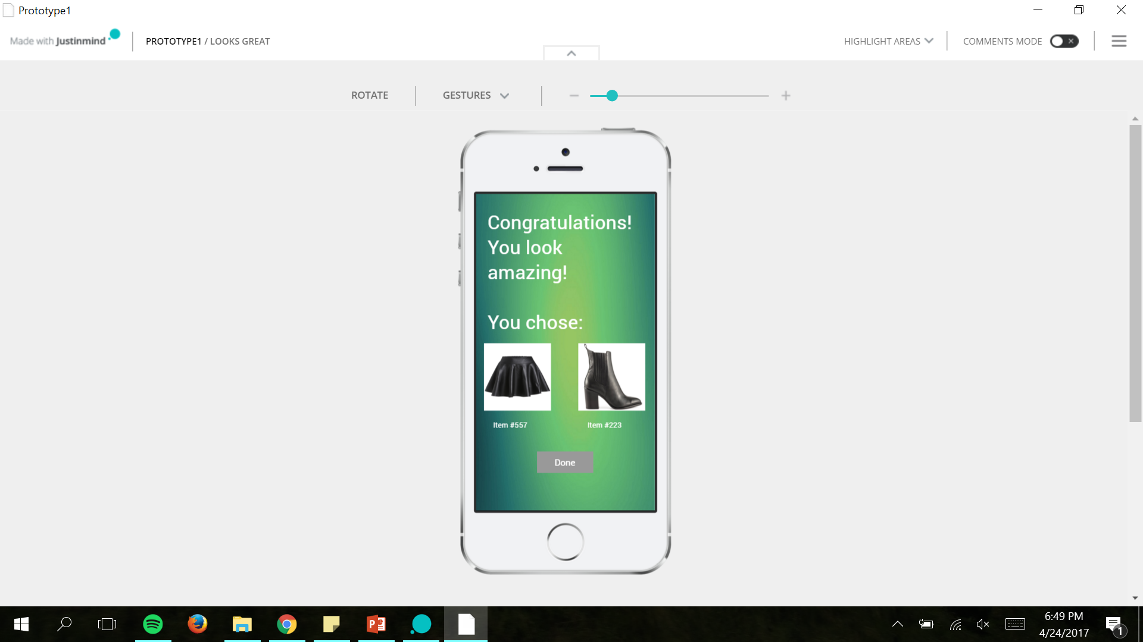
Our Virtual Prototype -App mock up

Slide 13
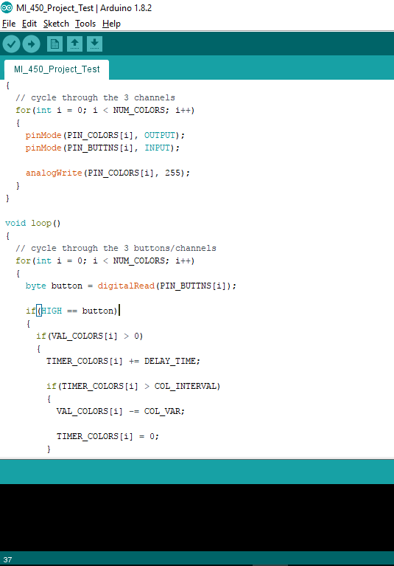
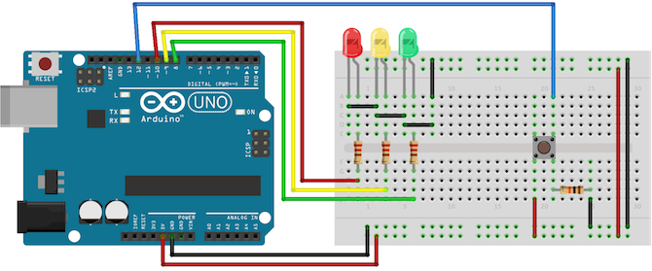
Smart hanger prototype lighting
Image from : http://www.makeuseof.com/tag/arduino-traffic-light-controller/

Slide 14
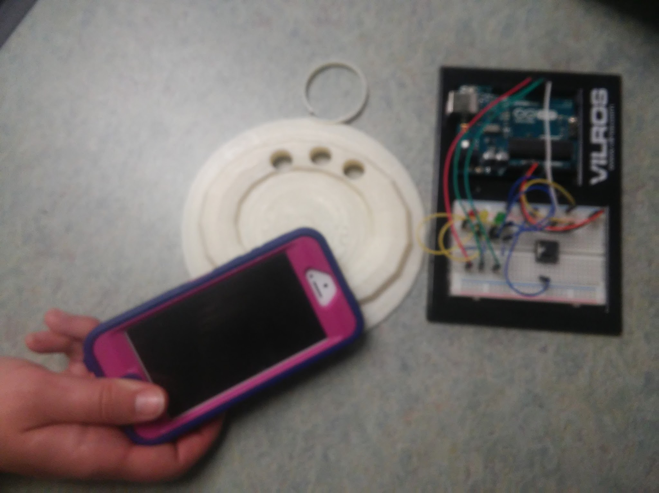
Our prototype synthesized

Slide 15
Evaluation
We found the individual components worked well, however all put together, users had a hard time connecting them all.
Present relevant information quickly and efficiently
The functionalities were evaluated as unobtrusive and could fit into schedules without much modification

Slide 16
Improvements
What was missing?
Where could we go with this?
What did we achieve
Notes:
Missing: Our users wanted more or better “instant feedback” from the device & interface, others thought the device should be the app itself, or wish there was a way to interact with the app and device away from their homes & closets. (Like checking if something was dirty or not rather than having to be home to check). Our main goal was to make the daily routines for our users easier, something that would be helpful, beneficial, and convenient to them.

Slide 17
Improvement Ideas
Smart hanger device improvements
Better design, fit more naturally on hanger
Mobile application/ device improvements
bigger advancement, maybe an entire
“Smart Closet”
Make the device itself be the app with Siri
…
…
Notes:
Kristen. For the smart hanger high-fidelity prototype we would make sure all the colored LED buttons were working in the more simplified version I showed earlier, and there would be a way to “clip” the device on the hanger rather than having to hang it on the hanger. As for the smart closet idea, we had some of my testers suggest that we could go above and beyond our entire idea by making the entire closet organize outfits, put clothes in your hamper when they are dirty, and even put your articles of clothing back in the right spot after washing them.

